Slide 1
Deploying SharePoint Framework components to production
Deploy assets for production usage

Slide 2
Agenda
Deploy to Azure Storage
Deploy to SharePoint CDN
Package and deploy
Update your Web Part

Slide 3
Using Azure Storage

Slide 4
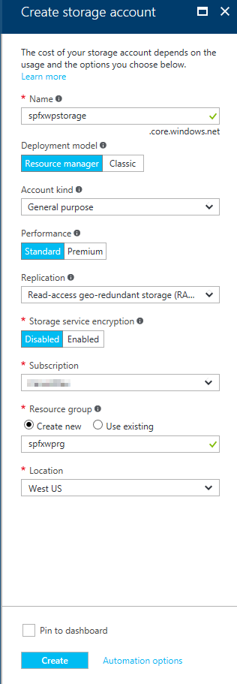
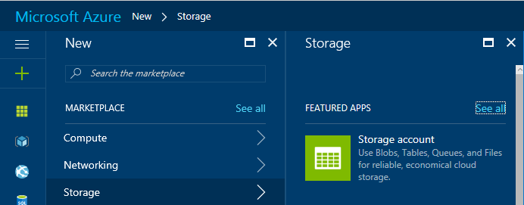
Create Azure Storage Account
Go to the Azure Management Portal
Create a new Storage Account

Slide 5
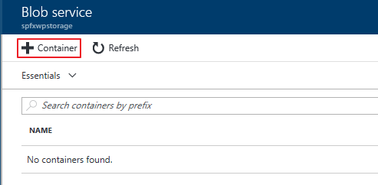
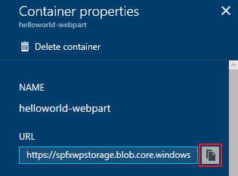
Create a Blob Container in the Storage Account
Create a Blob Container and copy the URL

Slide 6
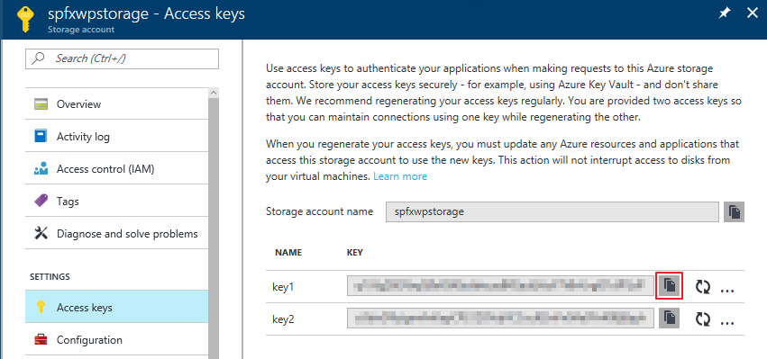
Obtain Storage Account Access Key
The Storage Account Access Key is used to automate deployments to the Azure Storage CDN, copy one of the keys

Slide 7
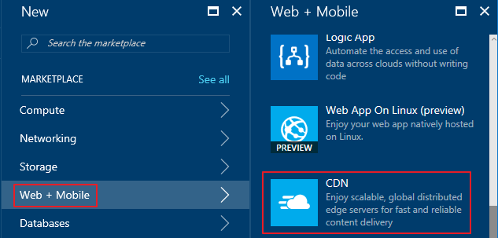
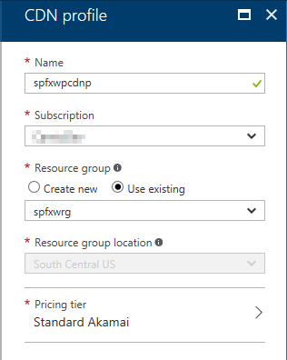
Create CDN Profile
In the Azure Management Portal, create a new CDN Profile

Slide 8
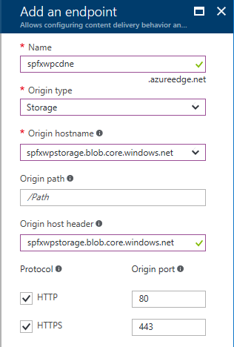
Create CDN Endpoint
In the CDN Profile, create a new CDN endpoint

Slide 9
Configure the web part to deploy assets to the CDN
Update the account, container, and accessKey in the deploy-azure-storage.json file
account – Storage account name
container – Name of the container you wish to use for the web part
accessKey – Storage Account Access Key
{
"workingDir": "./temp/deploy/",
"account": "spfxwpstorage",
"container": "helloworld-webpart",
"accessKey": "hL2503 … "
}

Slide 10
Configure the web part to use the CDN
Create CDN base path
Update the cdnBasePath in the write-manifests.json file
https://<Storage Account Name>.blob.core.windows.net/<Container Name>
{
"cdnBasePath": "https://spfxwpstorage.blob.core.windows.net/helloworld-webpart"
}

Slide 11
Deploy web part assets to the Azure Storage Account
Use the deploy-azure-storage gulp task to deploy the assets to the Azure Storage Account
> gulp deploy-azure-storage
> gulp deploy-azure-storage
Build target: DEBUG
[11:56:24] Using gulpfile C:\SPFx\helloworld-webpart\gulpfile.js
[11:56:24] Starting gulp
[11:56:24] Starting 'deploy-azure-storage'...
[11:56:24] Starting subtask 'deploy-azure-storage'...
[11:56:24] [deploy-azure-storage] Uploading files '**/*.*' from directory './temp/deploy/' to Azure
[11:56:25] [deploy-azure-storage] Created container: helloworld-webpart
[11:56:25] [deploy-azure-storage] Uploading [3] files...
[11:56:26] [deploy-azure-storage] Uploaded file: helloworld-webpart-helloworldstrings_en-us_536e65149b0acf4d52c0043073b9fc59.js
[11:56:26] [deploy-azure-storage] Uploaded file: hello-world.bundle_b8a80975dedeb31de300b580fab61182.js
[11:56:26] [deploy-azure-storage] Uploaded file: dd331d09-a9cd-448d-a687-7e43060191e2.json
[11:56:26] [deploy-azure-storage] Upload complete!
[11:56:26] [deploy-azure-storage] Access your files at: https://spfxwpstorage.blob.core.windows.net/helloworld-webpart
[11:56:26] Finished subtask 'deploy-azure-storage' after 1.92 s
[11:56:26] Finished 'deploy-azure-storage' after 1.93 s
[11:56:26] ==================[ Finished ]==================
[11:56:27] Project helloworld-webpart version: 0.0.1
[11:56:27] Build tools version: 2.4.0
[11:56:27] Node version: v6.10.0
[11:56:27] Total duration: 5.94 s
deploy-azure-storage

Slide 12
DEMO
Deploy web part resources to an Azure Storage CDN
Notes:
Use Exercise 3: Deploy the web part resources to an Azure Storage CDN in the lab manual.

Slide 13
Using SharePoint CDN

Slide 14
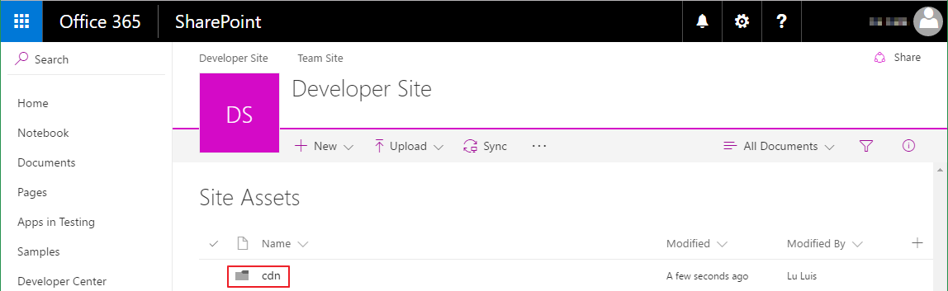
Create SharePoint CDN origin
Go to the Site Assets Document Library
Create a folder for the CDN origin

Slide 15
Enable the SharePoint CDN origin
Open the SharePoint Online Management Shell
Execute the following Powershell commands to enable the CDN, set the CDN origin, and return the CDN Origin ID
> $creds = Get-Credential
> Connect-SPOService -Url https://<TENANCY>-admin.sharepoint.com/ -Credential $creds
> Set-SPOTenant -PublicCdnEnabled $true
> Set-SPOTenant -PublicCdnAllowedFileTypes "CSS,EOT,GIF,ICO,JPEG,JPG,JS,MAP,PNG,SVG,TTF,WOFF,TXT"
> New-SPOPublicCdnOrigin -Url "https://<TENANCY>.sharepoint.com/sites/<SITE>/siteassets/cdn"
> Get-SPOPublicCdnOrigins
Notes:
Open the SharePoint Online Management Shell.
https://www.microsoft.com/en-us/download/details.aspx?id=35588&e6b34bbe-475b-1abd-2c51-b5034bcdd6d2=True&fa43d42b-25b5-4a42-fe9b-1634f450f5ee=True
Connect to your Office 365 Developer Tenant within PowerShell session by executing the following commands:
$creds = Get-Credential
Connect-SPOService -Url https://<TENANCY>-admin.sharepoint.com/ -Credential $creds
Enable the Public CDN in the tenant by executing the following command:
Set-SPOTenant -PublicCdnEnabled $true
Configure the allowed file extensions by executing the following command:
Set-SPOTenant -PublicCdnAllowedFileTypes "CSS,EOT,GIF,ICO,JPEG,JPG,JS,MAP,PNG,SVG,TTF,WOFF,TXT“
Add the CDN Origin by executing the following command:
New-SPOPublicCdnOrigin -Url "https://<TENANCY>.sharepoint.com/sites/dev/siteassets/cdn“
Get the CDN Origin Id by executing the following command:
Get-SPOPublicCdnOrigins

Slide 16
Configure the web part to use the CDN
Create CDN base path
Update the cdnBasePath in the write-manifests.json file
https://publiccdn.sharepointonline.com/<TENANCY>.sharepoint.com/<your-CDN-origin-Id>
{
"cdnBasePath": "https://publiccdn.sharepointonline.com/<TENANCY>.sharepoint.com/<your-CDN-origin-Id>"
}
Notes:
Your CDN base path should be: https://publiccdn.sharepointonline.com/<TENANCY>.sharepoint.com/<your-CDN-origin-Id>. Replace the <TENANCY> placeholder with the name of your Office 365 tenant, and the <your-CDN-origin-Id> placeholder with the CDN Origin Id you created in the previous steps.

Slide 17
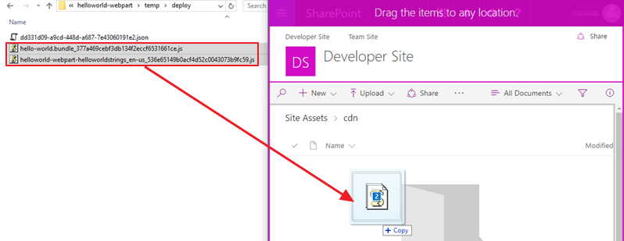
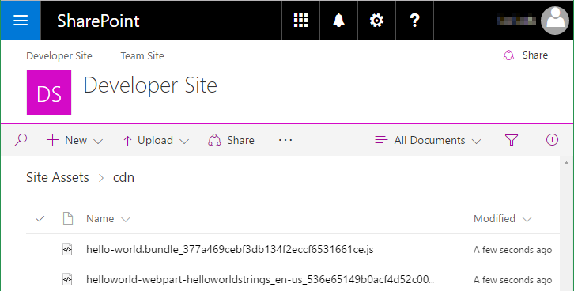
Deploy web part assets to the SharePoint CDN
Go to the Site Assets Document Library
Upload the assets for your web part to the CDN enabled folder

Slide 18
DEMO
Deploy web part resources to a SharePoint CDN
Notes:
Use Exercise 2: Deploy the web part resources to a SharePoint CDN in the lab manual.

Slide 19
Deploy assets to a CDN and configure web part
At this point the web part will not run
You must first
deploy the web part assets to a CDN location
update the cdnBasePath in the write-manifests.json file
{
"cdnBasePath": "<!-- PATH TO CDN -->"
}

Slide 20
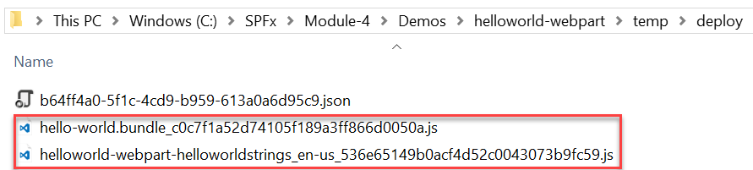
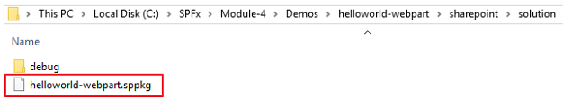
Package the web part
Use the bundle gulp task to build, localize, and bundle the project
Use the package-solution gulp task to package the project into a .sppkg file
The ship parameter build task creates a minified version of the bundle and copies all of the web part assets, including the web part bundle, into the temp\deploy folder. The .sppkg file is generated in the sharepoint\solution folder.
> gulp bundle --ship
> gulp package-solution --ship

Slide 21
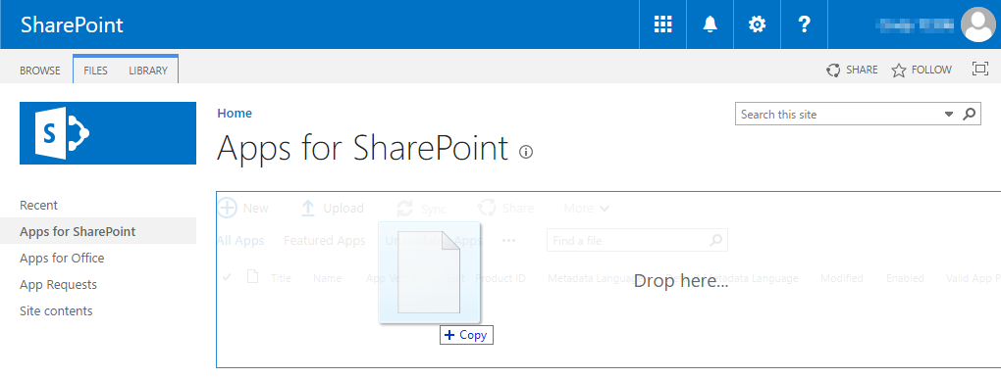
Deploy App to the SharePoint App Catalog
Go to your Office 365 App Catalog site
In the left sidebar, choose Apps for SharePoint
Upload the package (.sppkg file) for the web part

Slide 22
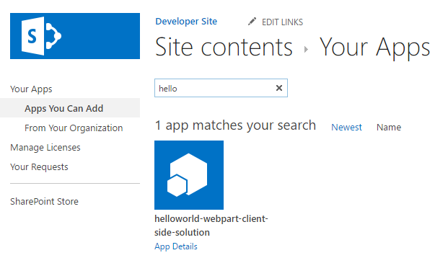
Install the App(Not needed for Tenant Scoped solutons)
Go to your Office 365 site
Add the App you just deployed to the SharePoint App Catalog

Slide 23
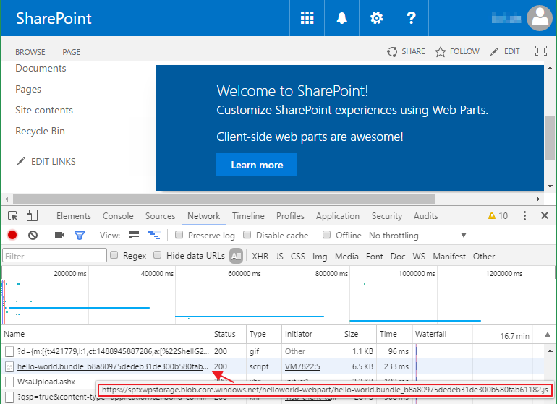
Add the web part to a SharePoint page
After the web part assets are deployed to a CDN location you can preview the web part
Create a page on your Office 365 site and add the web part to the page
In the developer console verify the assets are served from the CDN

Slide 24
DEMO
Package your Web Part
Notes:
Use Exercise 3: Deploy the web part resources to an Azure Storage CDN in the lab manual.

Slide 25
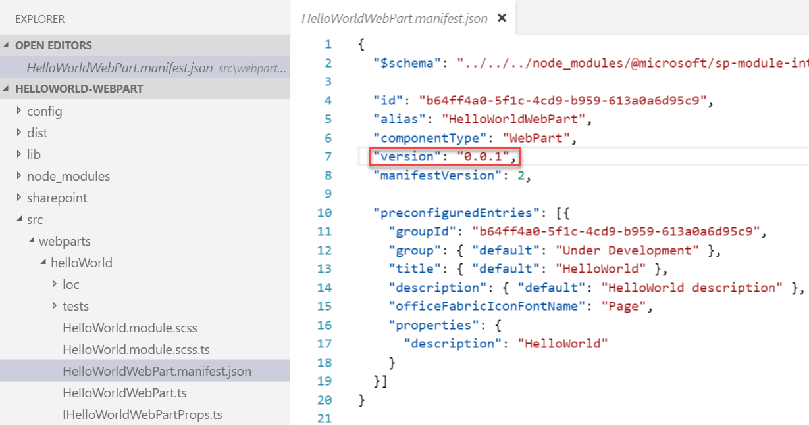
Update a web part and increment the version
Update the code or configuration for your web part
Increment the version in the <web part name>.manifest.json file
This sets the version for the web part
Multiple web parts in the same solution may be versioned independently

Slide 26
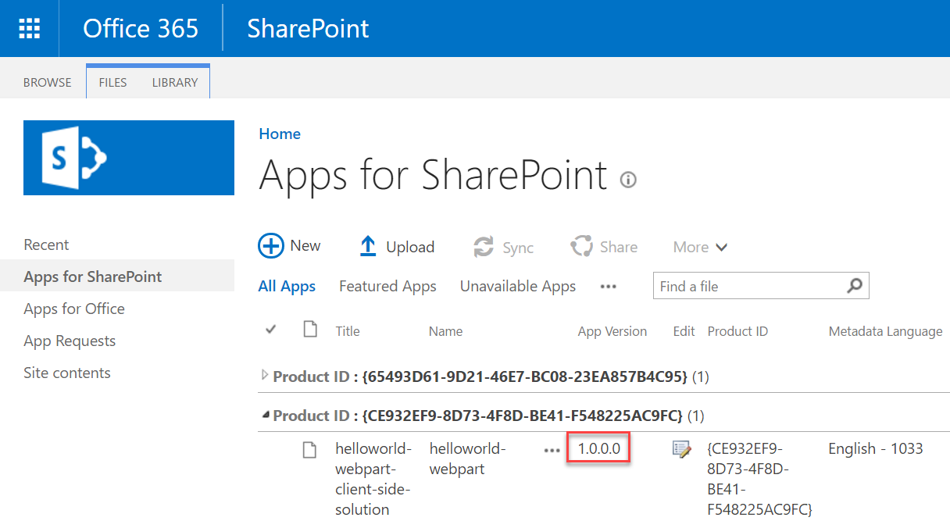
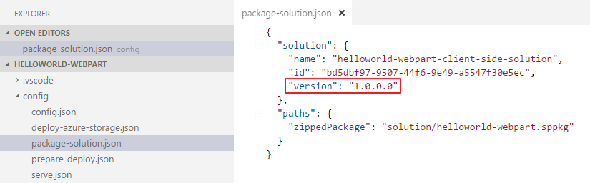
Update the version in the package-solution.json file
This sets the version for the .sppkg Add-in
This version is displayed in the app catalog

Slide 27
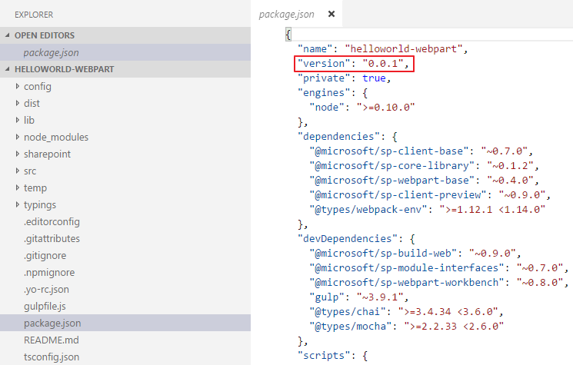
Update the version in the package.json file
Change the version every time the package changes
Notes:
The most important things in your package.json are the name and version fields. Those are actually required, and your package won't install without them. The name and version together form an identifier that is assumed to be completely unique. Changes to the package should come along with changes to the version.
Version must be parseable by node-semver, which is bundled with npm as a dependency. (npm install semver to use it yourself.)
More on version numbers and ranges at semver.

Slide 28
Package the web part
Use the bundle gulp task to build, localize, and bundle the project
Use the package-solution gulp task to package the project into a .sppkg file
The ship parameter build task creates a minified version of the bundle and copies all of the web part assets, including the web part bundle, into the temp\deploy folder. The .sppkg file is generated in the sharepoint\solution folder.
> gulp bundle --ship
> gulp package-solution --ship

Slide 29
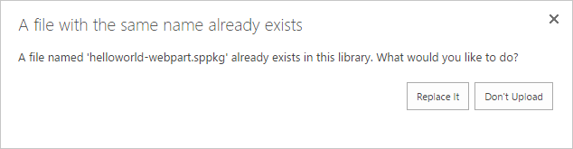
Deploy App to the SharePoint App Catalog
Go to your Office 365 App Catalog site
In the left sidebar, choose Apps for SharePoint
Upload the updated package (.sppkg file) for the web part

Slide 30
Deploy the updated web part assets to CDN
See the following sections for more information about CDN deployments
Deploying to SharePoint CDN
Deploying to Azure Storage CDN

Slide 31
Refresh the SharePoint page where the web part is deployed
You don’t need to install the App again
Refresh the SharePoint page where the web part was added, the update you made will take effect

Slide 32
DEMO
Update your webpart
Notes:
Use Exercise 2: Deploy the web part resources to a SharePoint CDN in the lab manual.

Slide 33
Summary
Package and deploy
Deploy to Azure Storage
Deploy to SharePoint CDN
Update your Web Part

